Slide 1
Augmented Reality for Children in a Confirmation Task: Time, Fatigue, and Usability
VRST 2019

Slide 2
INTRODUCTION
There is considerable interest in Augmented Reality (AR) educational tools for children.
One of the key factors in wide adoption of AR technology in schools is how usable it is for the target audience of children, who may not otherwise be familiar with virtual reality or AR.
Voice recognition systems designed for adult voices may not recognize child voices
Gesture interaction can be fatiguing
Using an unfamiliar controller to interact in AR may be less natural than other forms of interaction
To evaluate the usability of interaction methods for children using head mounted AR devices, we implemented a confirmation task to compare voice, gesture and controller interface methods.

Slide 3
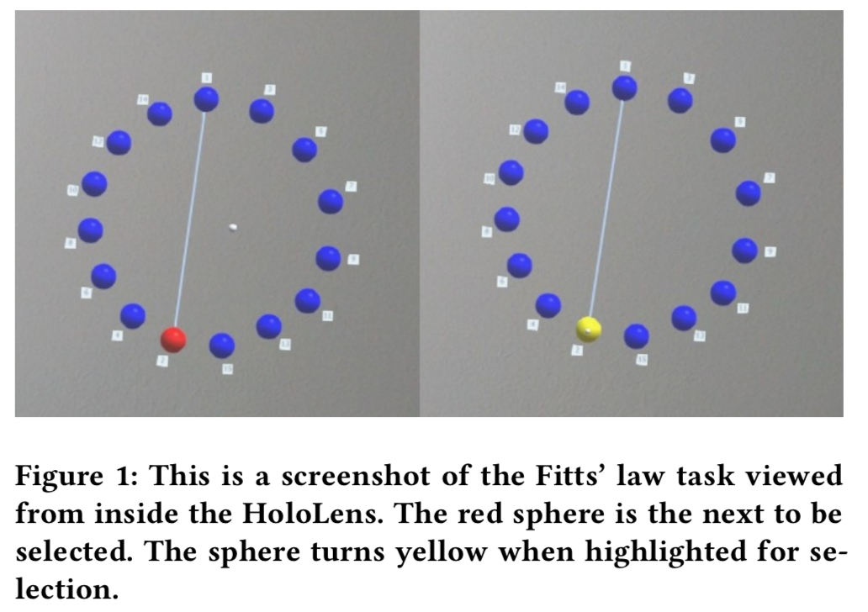
METHODS
Materials
We implemented a Fitts’ Law confirmation task on the Microsoft HoloLens using Unity 2017.4.20.
费茨法则：
任意一点移动到目标中心位置所需时间与该点到目标的距离和大小有关，距离越大时间越长，目标越大时间越短。
https://zhuanlan.zhihu.com/p/25530956

Slide 4
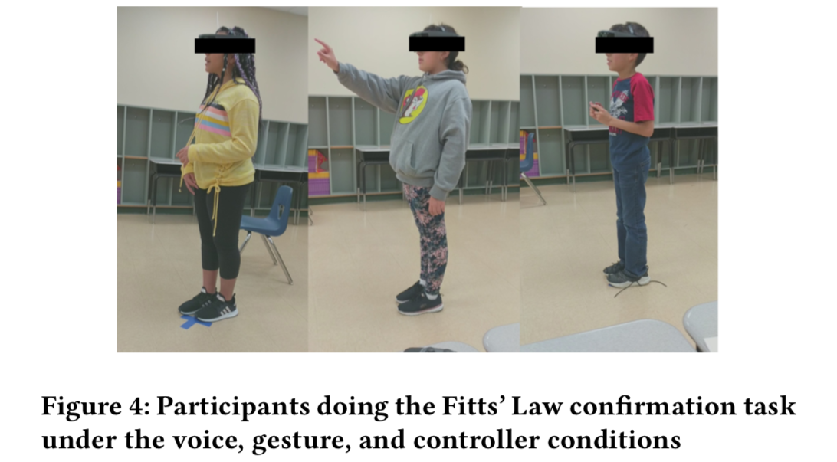
METHODS
Voice, Gesture, and Controller Interfaces
Voice: we implemented a separate keyword, “take” for the participants to say to choose spheres. (Not “select”)
Gesture: We used the “air tap” gesture recognition on the HoloLens for for our gesture condition
Controller: We used the two buttons on the front of the controller for selection.
In all three conditions, we added code to our HoloLens program to keep track of time elapsed while selecting objects.

Slide 5
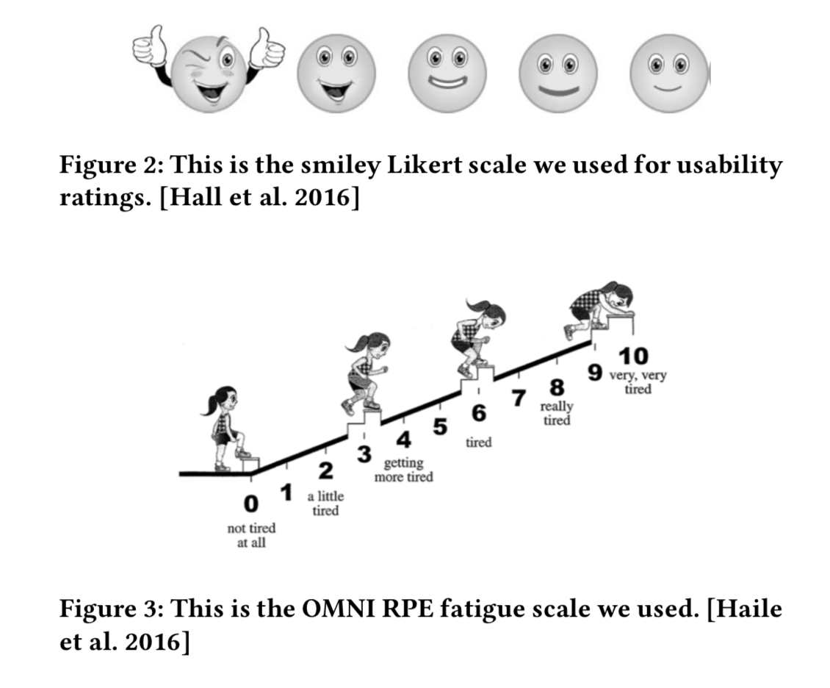
METHODS
Metrics
• Time: the average time it took participants to find and select each sphere in the Fitts’ law task under each input condition.
• Fatigue: the fatigue rating after performing the selection task under a given input condition.
• Usability: the participant’s rating on the System Usability Scale (SUS) after each input condition.

Slide 6
METHODS
Participants
The participants for our study were recruited from a local elementary school in the southwestern United States.
14 boys and 8 girls, 22 Participants
Age from 9 to 11 years, with an average age of 10.3 years.
The ethnic composition of our participants was three African Americans, one Asian American and 18 Latino students.
All participants provided permission slips signed by their parent or guardian prior to their inclusion in the study. The permission slips and study have been approved by our university’s Institutional Review Board

Slide 7
METHODS
Procedure
Each participant was tested individually in a classroom at their school. The classroom measures approximately 30 by 40 feet. The researcher sat at a table on the side of the room.
We asked each participant to stand on a blue “X” marked on the floor and face the back wall of the classroom. The location of the spheres in the Fitts’ Law task was determined in the HoloLens program relative to the position of the participant.
We asked each participant their age, gender and ethnicity. We also asked them to rate their initial fatigue level.
We explained what they would be doing during the study and how to use the first interface. We explained each interface just before the participants completed the task using that interface.
After the participants finished the task using one type of interface, we asked them to again rate their fatigue and to answer questions from the System Usability Scale.

Slide 8
METHODS
Hypotheses
• Hypothesis 1: There are significant differences between selection time for voice, controller and gesture.
• Hypothesis 2: There are significant differences between fatigue level for voice, controller and gesture.
• Hypothesis 3: There are significant differences between usability for voice, controller and gesture.

Slide 9
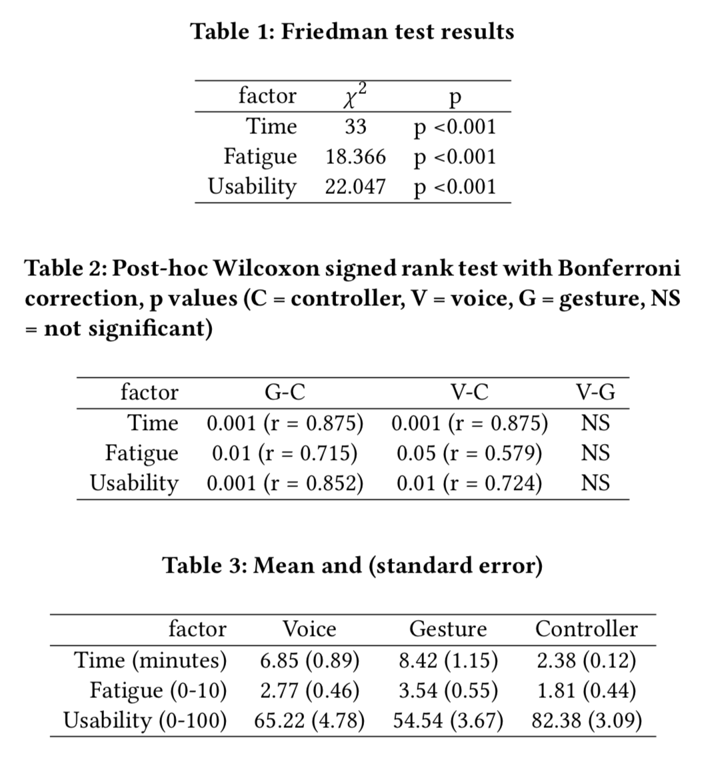
RESULT
We ran Friedman tests（弗里德曼双向秩方差分析） on the time, fatigue, and usability data and found a significant effect of group for all three.
We also ran post-hoc tests using the Wilcoxon signed rank test(Wilcoxon有符号秩检验) with Bonferroni correction (Bonferroni校正).
We can accept H1, H2, and H3 for differences between Gesture and Controller and between Voice and Controller.
We cannot accept H1, H2, or H3 for differences between Voice and Gesture.
Mean and standard error for time, fatigue, and usability are shown in Table 3.
Voice and gesture selection both took longer than controller selection.
Fatigue was highest under the gesture condition, and lowest under the controller condition.
Gesture was also the least usable interface, according to our participants, while controller was rated highest on usability.
弗里德曼双向秩方差分析: https://baike.baidu.com/item/%E5%BC%97%E9%87%8C%E5%BE%B7%E6%9B%BC%E6%A3%80%E9%AA%8C
Wilcoxon有符号秩检验: https://www.cnblogs.com/djx571/p/10216940.html
Bonferroni校正: https://baike.baidu.com/item/Bonferroni%E6%A0%A1%E6%AD%A3/8646271?fr=aladdin

Slide 10
CONCLUSION
There are several ways to interact with the Microsoft HoloLens, via voice recognition, gesture recognition, and a controller.
We implemented a Fitts’ Law confirmation task to compare usability of these three interaction methods when used by children.
We found significant differences in time, fatigue and usability between the voice and controller interaction methods. We also found significant differences in time, fatigue and usability between the gesture and controller interaction methods.
Compared with voice and gesture, controllers are the most usable interfaces for tasks in head-gaze pointing in AR for children.

